Slide 1
CrossEntropy Loss
How to train a classifier

Slide 2
Classifier
A classifier is a type of model that is trained to categorize input data into classes.
The most used loss function to train a classifier is the crossentropy loss.
model
input
class

Slide 3
Binary Classifier
A binary classifier is a classifier which can only distinguish between two classes.
model
image
dog
not dog

Slide 4



Binary Classifier: Logistic Regression
In the logistic regression scenario, we aim to train our network to output the probability of the input being in the target class.
model
99%
model
60%
model
5%

Slide 5

Logistic Regression: Sigmoid Function
The sigmoid function, also known as the logistic function, is a function that maps any real-valued number to a value between 0 and 1. It is commonly used in logistic regression to model the probability that a given input belongs to a particular class

Slide 6
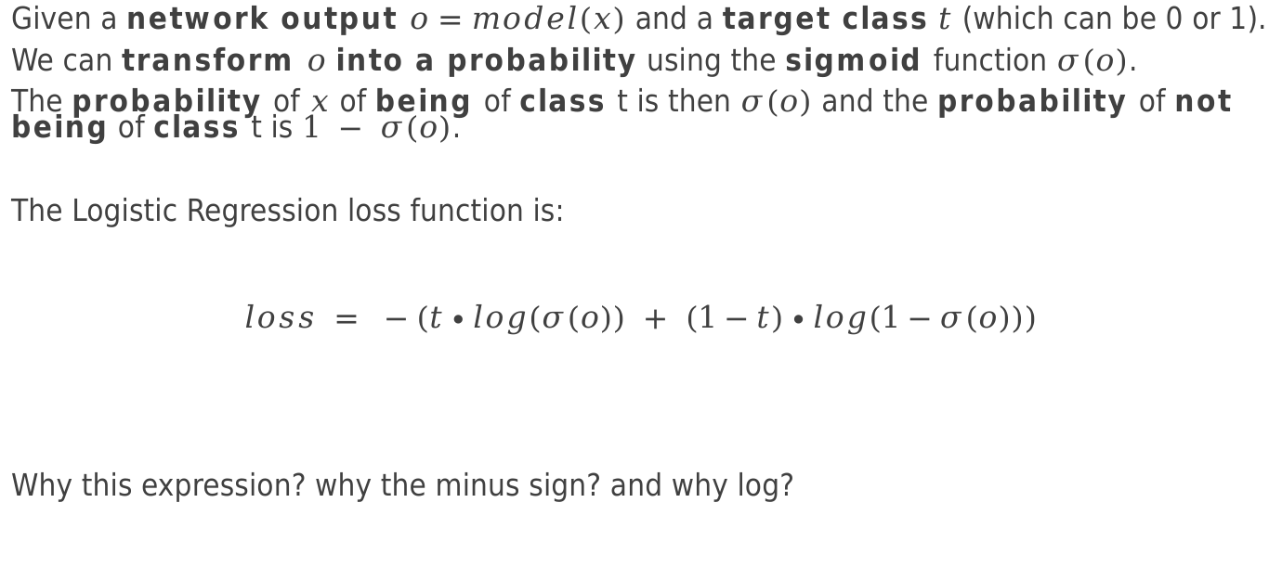
Binary Classifier: Logistic Regression loss
Given a network output $o=model(x)$ and a target class $t$ (which can be 0 or 1).
We can transform $o$ into a probability using the sigmoid function $σ(o)$.
The probability of $x$ of being of class t is then $σ(o)$ and the probability of not being of class t is $1 − σ(o)$.
The Logistic Regression loss function is:
$$loss = −(t∙log(σ(o)) + (1−t)∙log(1−σ(o)))$$
Why this expression? why the minus sign? and why log?

Slide 7
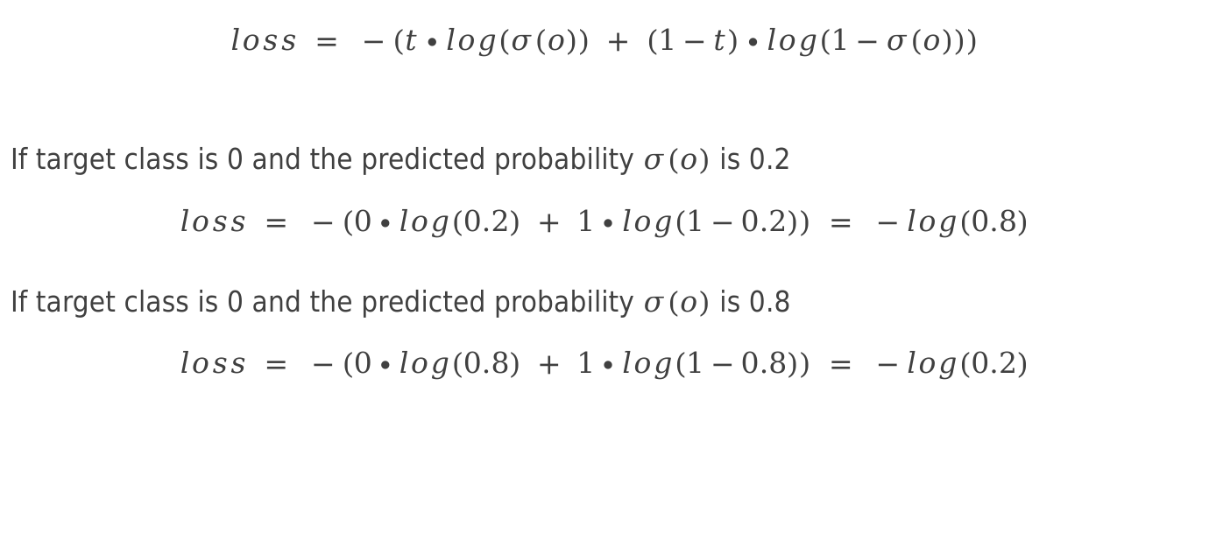
Binary Classifier: Logistic Regression loss
$$loss = −(t∙log(σ(o)) + (1−t)∙log(1−σ(o)))$$
If target class is 0 and the predicted probability $σ(o)$ is 0.2
$$loss = −(0∙log(0.2) + 1∙log(1−0.2)) = −log(0.8)$$
If target class is 0 and the predicted probability $σ(o)$ is 0.8
$$loss = −(0∙log(0.8) + 1∙log(1−0.8)) = −log(0.2)$$

Slide 8
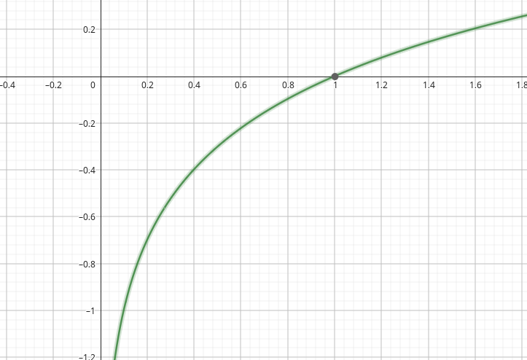
Binary Classifier: Logistic Regression loss
target 0 and predicted 0.8 = -log(0.2)
target 0 and predicted 0.2 = -log(0.8)
big error
small error
The error
is exponentially
larger w.r.t. the
predicted probability
error

Slide 9
More than two classes
A classfier is trained to classify an input into more than two classes.
The output of the model should be a categorial distribution.
A categorical distribution is a probability distribution used to model the likelihood of distinct classes, each class has an associated probability.
The probabilities sum to 1, reflecting the exclusive nature of the categories.
dog = 60%
model
cat = 5%
pokemon = 25%

Slide 10
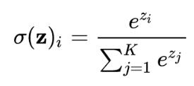
Classifier: the softmax function
The softmax function is a function that takes as input a vector of real numbers and transforms it into a categorical probability distribution.
4
0.5
softmax
2
0.25
2
0.25

Slide 11
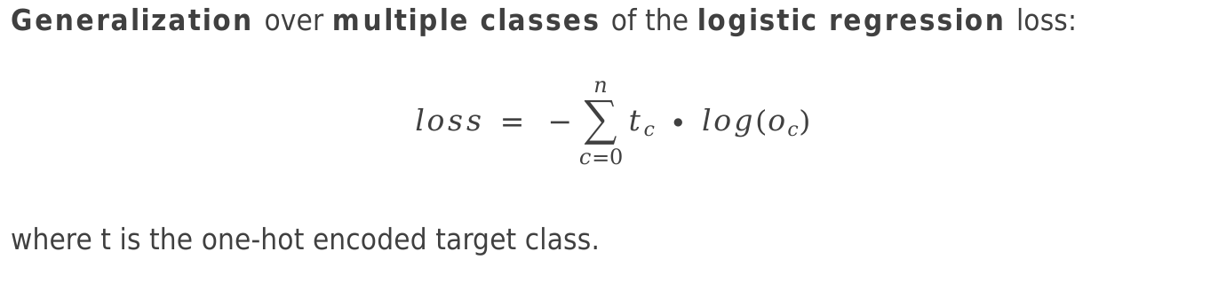
Classifier: the crossentropy loss
Generalization over multiple classes of the logistic regression loss:
$$loss = −\sum_{c=0}^{n}{tc ∙ log(oc)}$$
where t is the one-hot encoded target class.
0
1
0
0
target = 2
target = 0
1
0
0
0

Slide 12
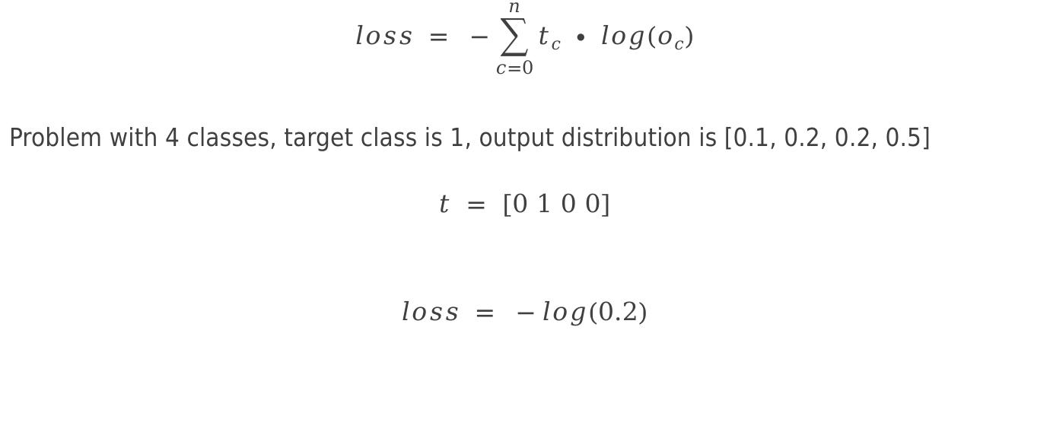
Classifier: the crossentropy loss
$$loss = −\sum_{c=0}^{n}{tc ∙ log(oc)}$$
Problem with 4 classes, target class is 1, output distribution is [0.1, 0.2, 0.2, 0.5]
$$t = [0 1 0 0]$$
$$loss = −log(0.2)$$
one-hot encoding
of class 1

Slide 13
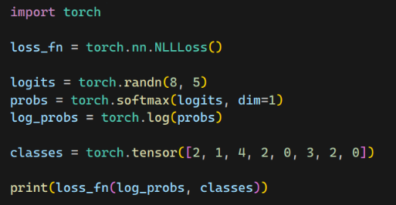
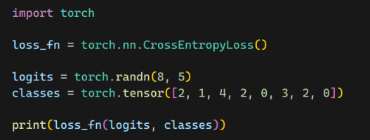
Crossentropy loss in PyTorch
The crossentropy loss is implemented in PyTorch in the class torch.nn.CrossEntropyLoss.
The forward function of the CrossEntropyLoss module accepts a tensor in the shape [batch, classes] and a tensor of classes in the shape [batch]

